Slide 1
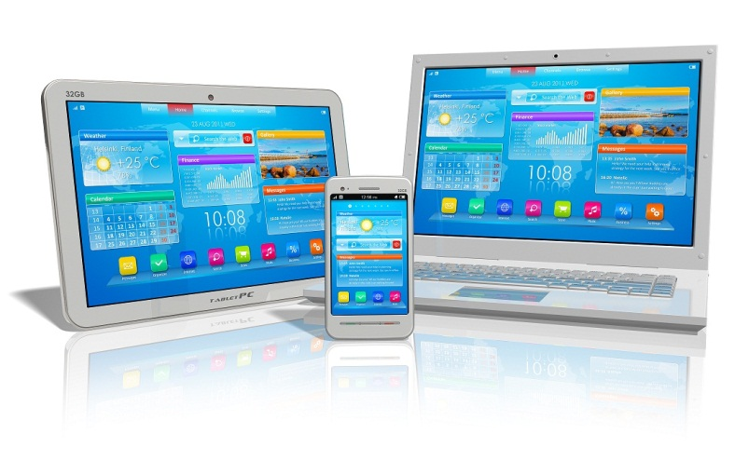
Mobile Devices in
Higher Education

Slide 2
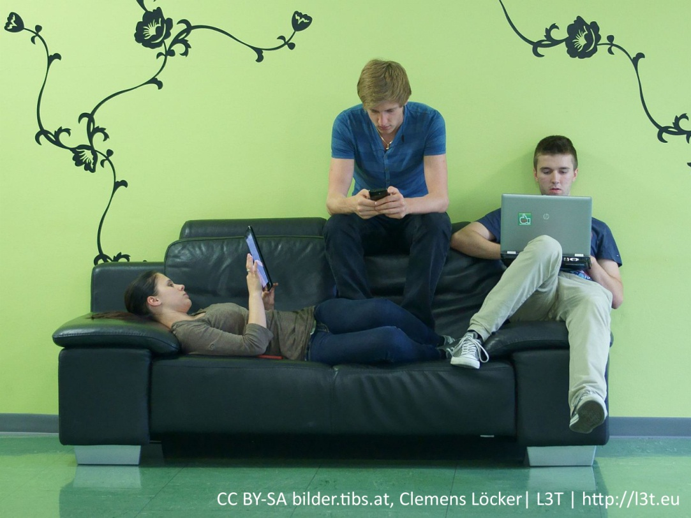
Mobile Devices as Educational Technology
All Educational Technology should widen the door for learners to learn, and lower the walls which prevent learners from learning.

Slide 3
Mobile devices…
“…provide a means to establish good
working relationships between the faculty and students. The
technologies can help build cohesive research teams. Tablets
and smartphones can provide a personal learning and
researching environment for any undergraduate research
project, whether for recording data, storing and manipulating
field notes (written, audio, and images), or “traditional”
use of the web and cloud-based applications. Indeed, students
could manage their research project from start to finish
on a tablet, including making corrections to manuscripts
and sending the final copy to a journal or to a conference
as a poster presentation. Students could even finish their
research by presenting a talk via a tablet (Whalley, 2013).

Slide 4
Mobile Devices owned by learners are considered a part of a personal learning environment.
“The term personal learning environment (PLE) describes the tools, communities, and services that constitute the individual educational platforms learners use to direct their own learning and pursue educational goals. A PLE is frequently contrasted with a learning management system in that an LMS tends to be course-centric, whereas a PLE is learner-centric. At the same time, a PLE may or may not intersect with an institutional LMS, and individuals might integrate components of an LMS into the educational environments that they construct for themselves” (Educause, 2009).

Slide 5
Objectives
Benefits
Use
Barriers

Slide 6
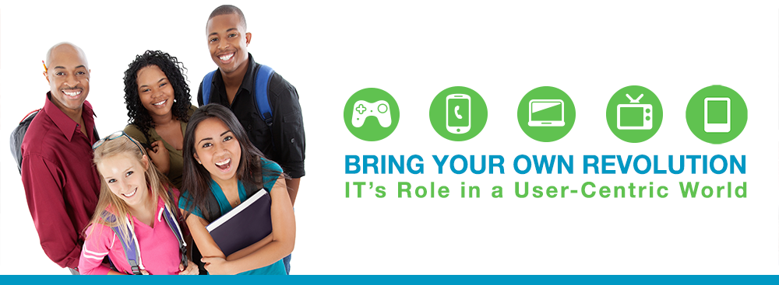
Benefits
Widening the doorway:
The doorway to learning is made of Learners, Educators, and Administrators, and Instructional Designers.
Accessibility for learners
Tethered/untethered
Synchronous/Asynchronous Learning
Traditional, Blended, and Distance (or online) formats
Cost for learners
Ease of information distribution for educators

Slide 7
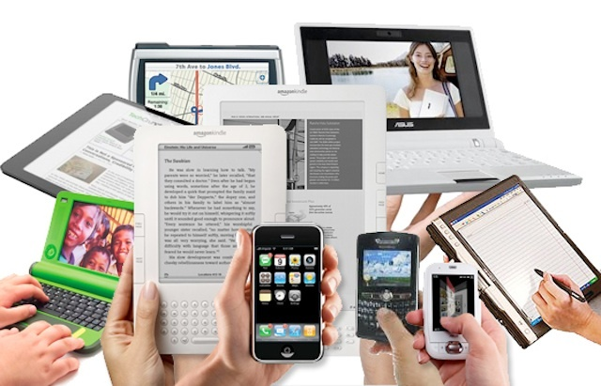
The most common mobile devices are Laptops, Cell phones, and Tablets.
“Tablets are emerging as the device of choice in a multiple device ecosystem. They're light, they access the digital world, and they work using the normal web and apps (which are turning into a boundless economic, learning, social, and cultural ecosystem)”(Abram, n.d.).

Slide 8
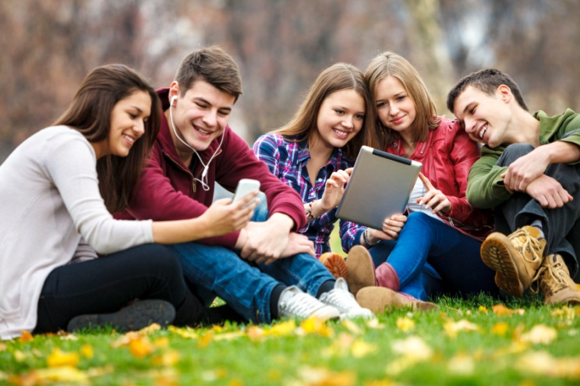
Benefits
Accessibility for learners
Untethered learning allows students to access educators, other students, and learning resources from almost anywhere, anytime.
The implementation of simultaneous synchronous/asynchronous learning allows for educational social engagement without losing the untethered freedom of a purely online learning environment for learners who rely on their devices as their primary learning interface.

Slide 9
Benefits
Cost for learners
Low-end tablets and cell phones capable of accessing online courses and running productivity and communication apps are available for about the price of 15-20 hours of minimum wage work. Since many learners often own these devices for social and professional reasons before engaging in formal learning, the BYOD (Bring Your Own Device) philosophy can be implemented in many Higher Education fields with reliability. Students who don’t have devices can be facilitated with institution owned devices (like iPad labs).
20 years ago, the cost of a low-end laptop would equate to well over 300 hours of minimum-wage work.
“Smartphones are becoming more affordable and ubiquitous”
(Melhuish and Falloon 2010).

Slide 10
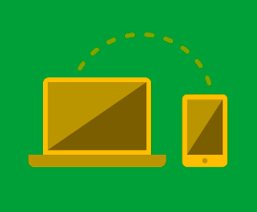
Benefits
Ease of information distribution for educators
Educators of traditional, blended, and fully-online learners in courses which utilize a bowser accessible LMS give their students the advantage of being able to push out diverse media and engaging learning materials, and
communicating in various non confrontational text-based engaging environments (such as synchronous/asynchronous chat-rooms from web-based conferences) or forums, or messaging systems.

Slide 11
General Use
Use of mobile devices is for consumption, production, or communication.
“Mobile technologies today provide an efficient and accurate
way to capture, store, analyze, and share data during field
Research” (Whalley, 2013).
Learners:
Reading Textbooks/ebooks/scholarly articles/Field research
Writing and producing media
Communicating with instructors and other students
Educators:
Use as “clickers”, use for “engagement”
Communication synchronously/asynchronously

Slide 12
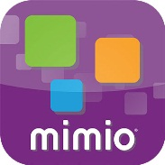
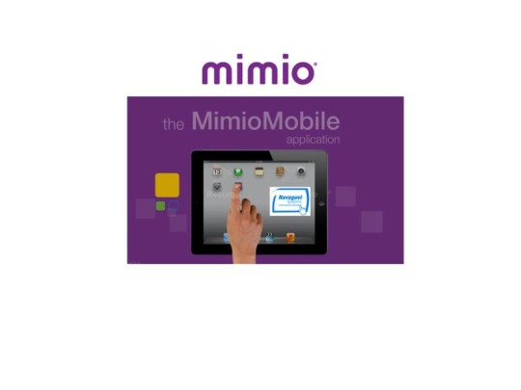
Use: Mimio Mobile
Apps, such as MimioMobile allow educators in traditional classrooms to push e-books, rich-media, pod-cast, and other learning materials out to student devices.
MimioMobile also allows students to quickly partake in surveys, as they use their devices as educational “clickers” to provide lively, engaging measurable results on-screen at the front of the classroom, and on the devices—all of which the instructor controls.

Slide 13
Barriers
There are many barriers which learners, educators, administrators, and designers must face when anticipating the implementation of Mobile Devices in an educational strategic plan. Listed are a few:
New technology can create extra steps between learner and educational outcome.
Electronic technology interfaces evolve regularly (change happens fast) which embeds a constant learning curve for the technology.
Institutions which implement BYOD philosophy must find ways to facilitate learners who don’t own mobile devices.
Technology breaks, and although it is relatively inexpensive, it is not free.
Battery life and connectivity and screen-size are not always ideal

Slide 14

Some students are not already skilled at using digital technology, due not only to economic barriers to owning and using computers at home but also to psychosocial obstacles such as fear (Stanley 2003).

Slide 15
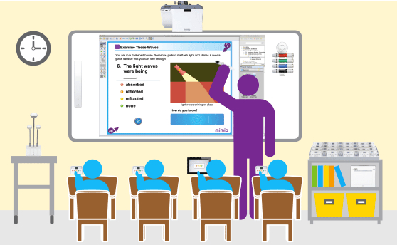
Despite these barriers, well implemented use of these devices can dramatically enhance learner engagement
“Overall, the opportunities offered by mobile devices to support inquiry-based learning are great and should be embraced by faculty, who might be surprised by how informed, engaged, and skillful their students are with mobile devices” (Whalley, 2013).

Slide 16
Bibliography
Abram, S. (n.d.). Preparing Our Schools for the BYOD World, 10–12.
Whalley, W. B. (2013). the International Desk, 34(2), 38–43.
Educause. 2009. 7 Things You Should Know about Personal Learning Environments.
Available at: http://net.educause.edu/ir/library/pdf/ELI7049.pdf (accessed
09/28/2014).
Melhuish, Karen and Garry Falloon. 2010. “Looking to the Future: M-learning
with the iPad.” Computers in New Zealand Schools. Learning, Leading, Technology.
22: 1–16.
Stanley, L. 2003. Beyond access: Psychosocial barriers to computer
literacy. The Information Society 19 (5): 407–416.
Whalley, W. B. (2013). the International Desk, 34(2), 38–43.

